Slide 1



VitalTriage AI
A Smart Patient Segmentation Platform for Data-Driven Healthcare Operations
REPLACING MANUAL GUESSWORK WITH LOGIC-DRIVEN TRIAGE

Slide 2





PROBLEM STATEMENT
The Crisis in Healthcare Operations
The Core Challenge
Manual Triage is Failing Patients
Healthcare operations managers face a critical gap: without advanced analytics, classifying patients into urgency tiers is manual, subjective, and prone to human error. This creates cascading operational failures that directly impact patient outcomes.
Resource Mismanagement
Data Silos
Manual Overhead
Lack of a centralized dashboard makes it difficult for managers to see the "big picture" of ward health in real-time.
Clinicians spend valuable time on administrative categorization rather than direct patient intervention.
Beds, staff, and equipment are often assigned to "Stable" patients while "Critical" patients wait for care.
IMPACT
Delayed care, increased mortality
IMPACT
IMPACT
risk
Blind spots in decision-making
Reduced clinical throughput

Slide 3






PROBLEM DEEP DIVE
The Human Cost of Operational Inefficiency
Systemic Risk
The consequences of unstructured triage extend beyond inconvenience — they represent systemic risk to patient safety and institutional efficiency.
Subjective Classification: Without standardized thresholds, two clinicians may assign different urgency levels to identical vitals, creating inconsistency across shifts.
Delayed Critical Response: A patient with deteriorating oxygen saturation may be overlooked in a high-volume ward without automated alerting.
Audit & Compliance Risk: Manual records lack the traceability required for healthcare regulatory audits (e.g., HIPAA, CQC standards).
Clinician Burnout: Administrative burden from manual categorization reduces time available for direct patient care, contributing to staff fatigue.
"The right patient, in the right bed, at the right time"
THE OPERATIONAL IDEAL MANUAL SYSTEMS FAIL TO DELIVER

Slide 4

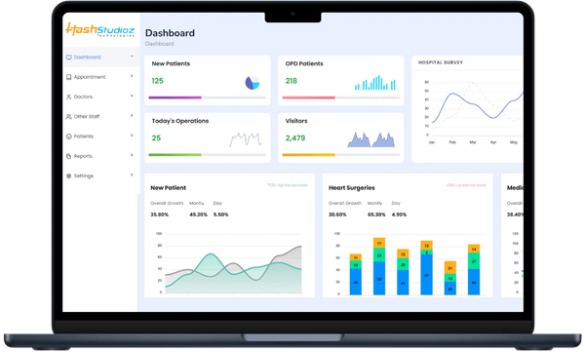
PROPOSED SOLUTION
Introducing VitalTriage AI
Logic-Driven Patient Prioritization
VitalTriage AI is a Smart Patient Segmentation Platform that replaces manual guesswork with a configurable, rule-based engine. It bridges the gap between raw medical data and real-time operational decision-making.
1
The Rule Engine
2
Automated Classifier
3
Managerial Dashboard
A configurable backend where Administrators define clinical thresholds for urgency classification.
A background service that continuously processes incoming patient vitals against the Rule Engine to auto-assign urgency status in real time.
A high-fidelity UI providing at-a-glance visibility into facility load, filterable by severity tier.
IF Oxygen Saturation < 90% AND Heart Rate > 110 bpm THEN Category = CRITICAL

Slide 5





CLASSIFICATION LOGIC
Patient Urgency Tiers
The platform segments every patient into one of three operational tiers based on measurable vital thresholds, enabling consistent, objective prioritization.
Critical
Moderate
Stable
CRITERIA EXAMPLE
CRITERIA EXAMPLE
CRITERIA EXAMPLE
SpO₂ < 90% AND HR > 110 bpm
SpO₂ 90–94% OR elevated temperature
All vitals within normal range
OPERATIONAL RESPONSE
OPERATIONAL RESPONSE
OPERATIONAL RESPONSE
Immediate escalation, priority bed assignment
Close monitoring, scheduled intervention
Routine care, standard resource allocation
Rule Engine Flexibility
Thresholds are fully configurable by authorized Administrators
Rules can be updated without system downtime
Multiple conditions can be combined using AND/OR logic for nuanced classification

Slide 6








TECHNICAL STRATEGY
Technical Architecture
Built for Production-Grade Healthcare
VitalTriage AI is designed using a modern, scalable technology stack optimized for reliability, security, and rapid deployment.
Development Stack
Key Architectural Principles
FRONTEND
BACKEND
Separation of Concerns
React.js / Streamlit
FastAPI (Python)
Rule Engine, Classifier, and Dashboard are independently deployable modules.
Professional, responsive UI/UX for the managerial dashboard
High-performance Rule Engine logic and REST API
Audit Trail by Design
DATABASE
AI AGENT
Every classification event is logged with timestamp, rule applied, and operator ID.
PostgreSQL (RDBMS)
LangChain + Streamlit
Patient records, audit trails, and rule storage
Custom Code Quality Checker for healthcare-grade compliance
Security-First
Role-based access control (RBAC) separates Admin and Manager permissions.

Slide 7
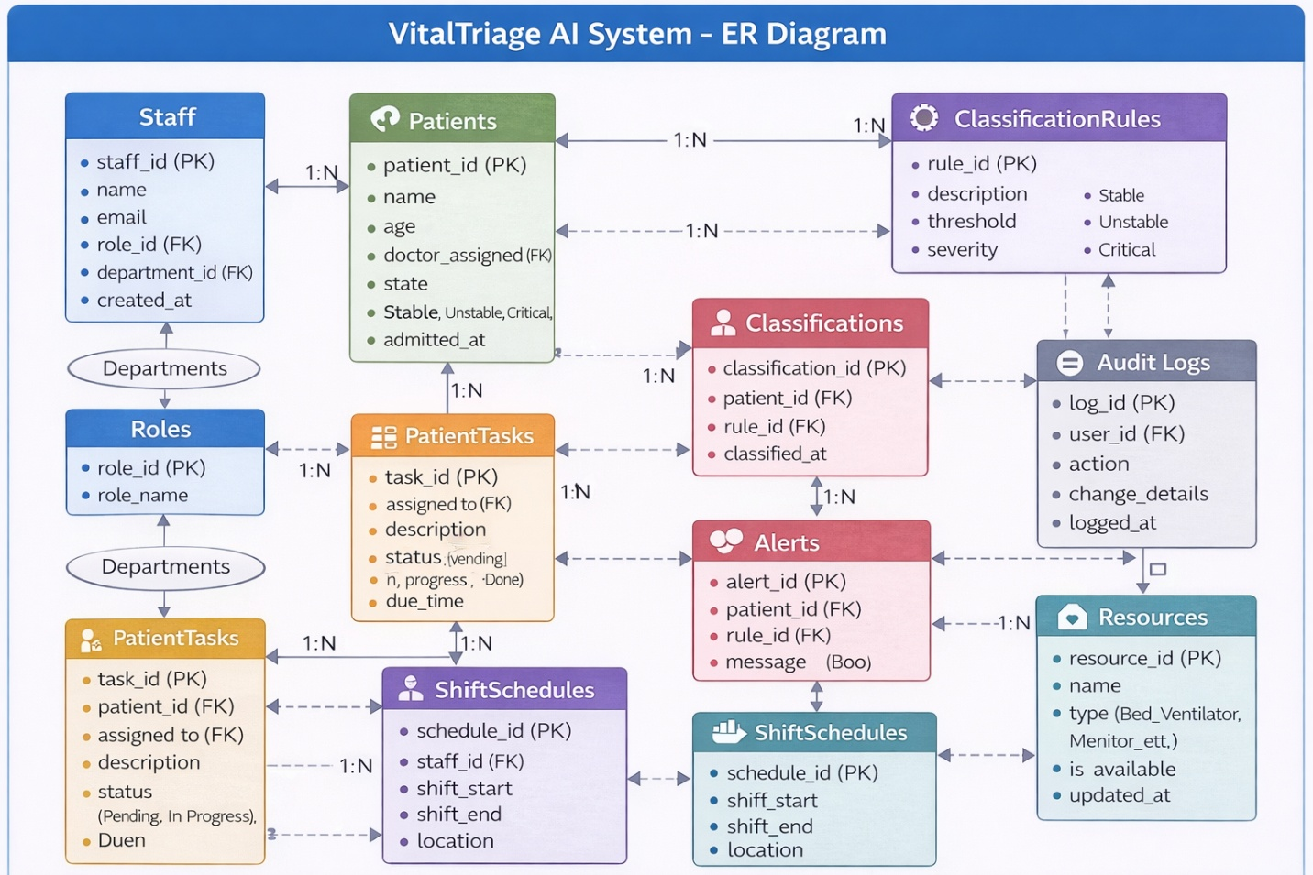

Slide 8




AI-AUGMENTED DEVELOPMENT
AI Agent Integration
To meet production-level quality requirements within a compressed timeline, VitalTriage AI employs a Multi-Agent AI Orchestration approach across every phase of the delivery workflow.
Phase
AI Tool / Agent
Usage
Requirements
Prompt Engineering Agent
Generates the Traceability Matrix from User Stories
Custom AI Code Reviewer (LangChain)
Design
D2 / Mermaid.js via AI
Auto-generates ER Diagrams and System Architecture diagrams
Ingests Python/JavaScript source code directly from the repository
Coding
GitHub Copilot / Cursor
Accelerates core Rule Engine logic development
Cross-references against a strict PEP8 + Healthcare Compliance checklist
Quality
Custom AI Code Reviewer
Enforces PEP8 compliance and healthcare security standards
Provides instant, actionable feedback before deployment to ensure production readiness

Slide 9




Logical Data Model
Three Core Entities
DATA ARCHITECTURE
The PostgreSQL database is structured around three primary entities that capture the lifecycle of patient classification and governance.
Users
Patients
Rules
KEY ATTRIBUTES
KEY ATTRIBUTES
KEY ATTRIBUTES
user_id (PK) role (Admin/Manager) access_level
patient_id (PK) vitals (SpO₂, HR, BP) current_tier
rule_id (PK) condition_logic severity_weight
ROLE IN SYSTEM
ROLE IN SYSTEM
ROLE IN SYSTEM
Governs authentication and authorization
Central record for classification and care tracking
Defines the configurable triage logic applied by the Rule Engine
Data Flow Overview
Admins create and update Classification Rules
The Classifier reads Rules and applies them to Patient vitals
All actions are logged against the Users entity for auditability

Slide 10


DELIVERY PLAN
Implementation Roadmap
From Concept to Deployment in 4 Hours
1
2
3
4
Requirements & Design
Backend Development
Frontend Development
QA & Deployment
45 MIN
90 MIN
60 MIN
45 MIN
Deliverables:
Deliverables:
Deliverables:
Deliverables:
User Stories, Traceability Matrix, ER
FastAPI Rule Engine, PostgreSQL
React/Streamlit Dashboard, Tier
Code review report, Deployment,
Diagram
schema, REST endpoints
visualization, Filters
Demo
AI Support:
AI Support:
AI Support:
AI Support:
Prompt Engineering Agent,
GitHub Copilot / Cursor
GitHub Copilot / Cursor
Custom LangChain AI Reviewer
Mermaid.js
Success Criteria
All three urgency tiers correctly classified against test patient data
Dashboard displays real-time tier distribution with filter functionality
AI Code Reviewer generates a compliance report with zero critical findings

Slide 11
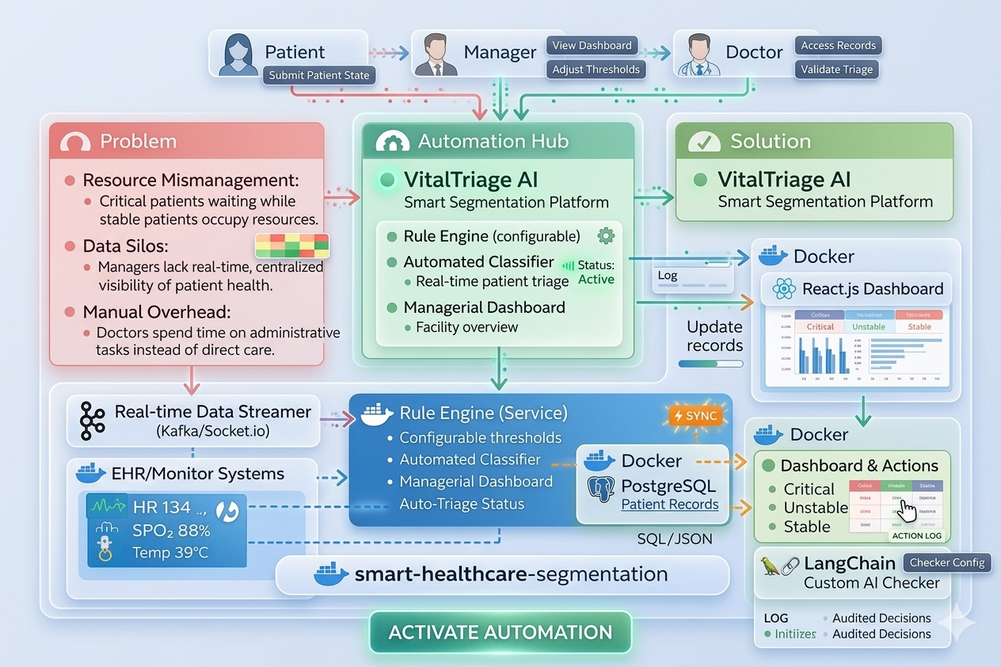
Solution
Architecture
All three urgency tiers correctly classified against test patient data
Dashboard displays real-time tier distribution with filter functionality

Slide 12
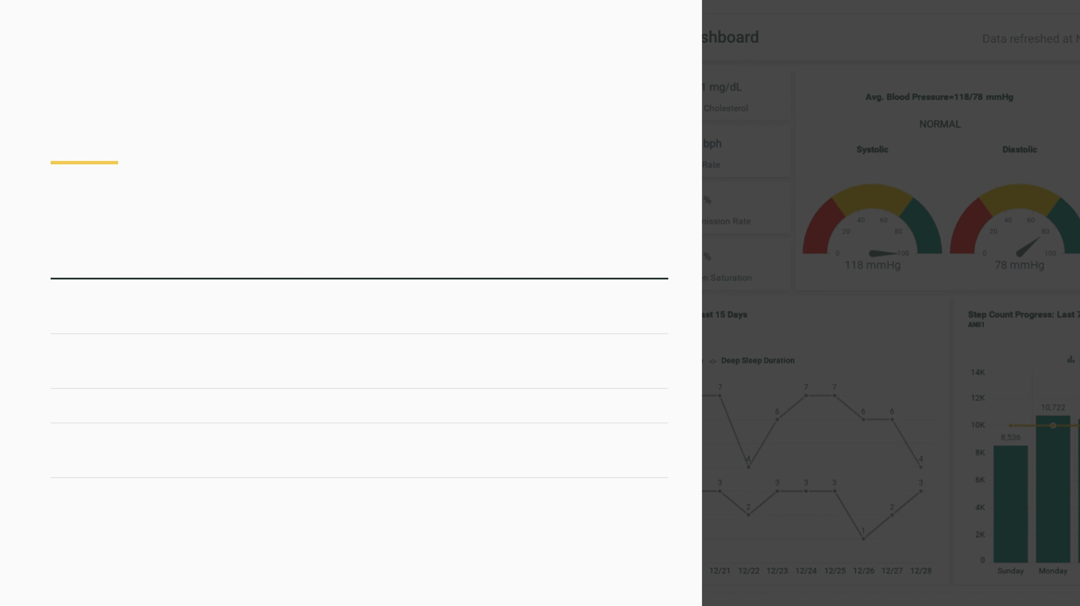
CONCLUSION
Summary & Strategic Value
VitalTriage AI transforms a fragmented, error-prone manual process into a reliable, data-driven operational backbone for healthcare facilities.
Dimension
Before
After (VitalTriage AI)
"Because in healthcare, the right decision at the right time saves lives."
Triage Method
Manual, subjective, shift-dependent
Automated, rule-based, consistent
Visibility
Fragmented data across departments
Unified real-time managerial dashboard
VITALTRIAGE AI
Compliance
Manual records, audit risk
Full automated audit trail
Clinician Time
Spent on administrative categorization
Redirected to direct patient care
THE STRATEGIC OUTCOME
By deploying VitalTriage AI, healthcare operations managers gain the tools to ensure that every critical patient receives timely attention, every resource is allocated with precision, and every decision is backed by traceable, auditable data.

Slide 13
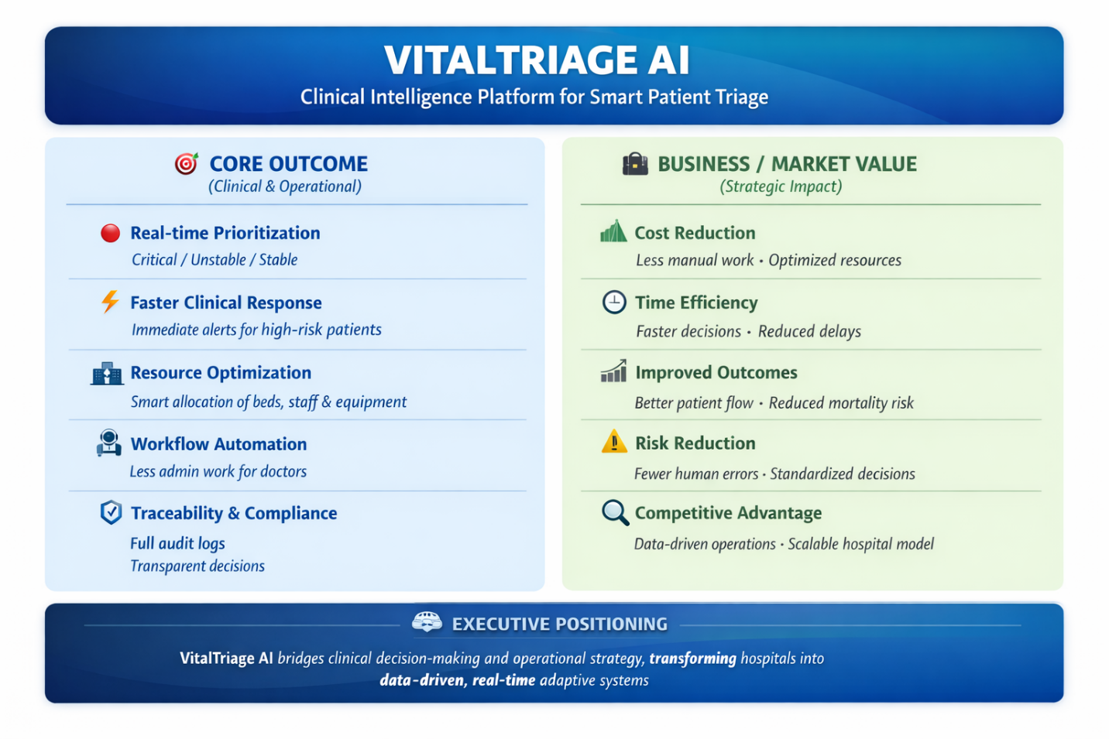
Business Outcome and Time to Market.

